Slide 1

Digital Electronic Systems
IY426
Combinational Basics
Monday 24-Jan-2022

Slide 2





Waveform
$$a$$
$$b$$
$$c$$
$$f1$$

Slide 3
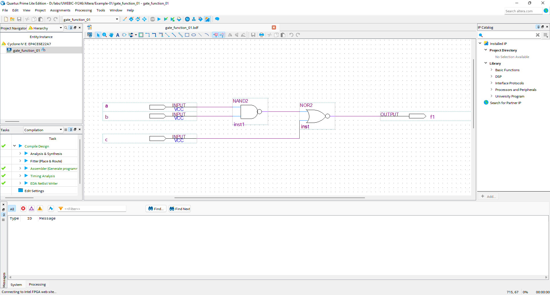
Quartus

Slide 4
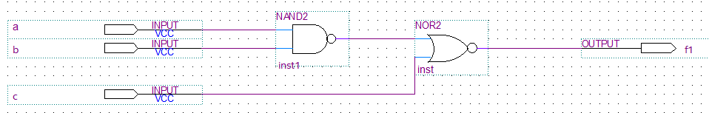
VHDL
ENTITY gate_function_vhdl IS
PORT(a: IN std_logic;
b: IN std_logic;
c: IN std_logic;
f1: OUT std_logic
);
END ENTITY gate_function_vhdl;
ARCHITECTURE behaviour of gate_function_vhdl IS
BEGIN
f1 <= NOT(NOT(a AND b) OR c);
END ARCHITECTURE behaviour;

Slide 5
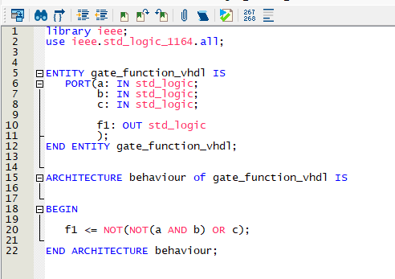
VHDL

Slide 6
Quartus

Slide 7
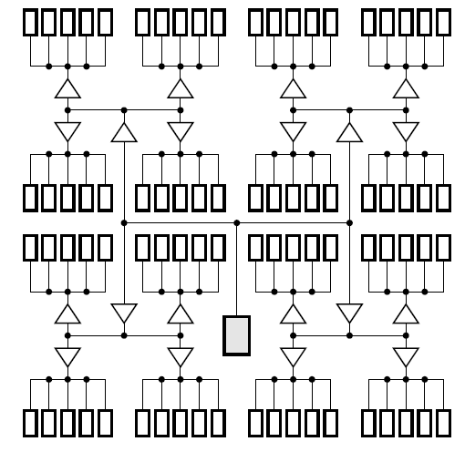

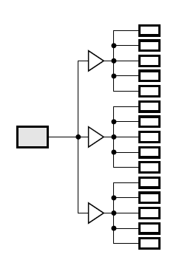
buffer

Slide 8
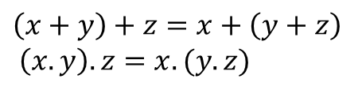
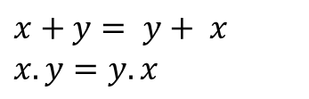
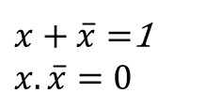
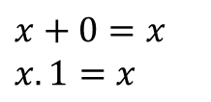
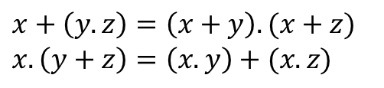
BOOLEAN ALGEBRA
Commutative laws:
Identity laws:
$$x+y= y+ x$$
$$x.y=y.x$$
$$x+0=x$$
$$x.1=x$$
Associative laws:
Complement laws:
$$\left(x+y\right)+z=x+\left(y+z\right)$$
$$\left(x.y\right).z=x.(y.z)$$
$x+\overline{x}=$1
$$x.\overline{x}=0$$
Distributive laws:
$$x+\left(y.z\right)=\left(x+y\right).(x+z)$$
$$x.\left(y+z\right)=\left(x.y\right)+(x.z)$$

Slide 9
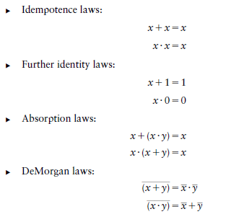
Useful Theorems:

Slide 10
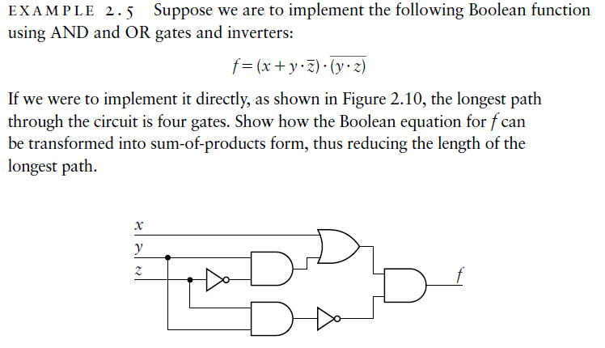
Example

Slide 11
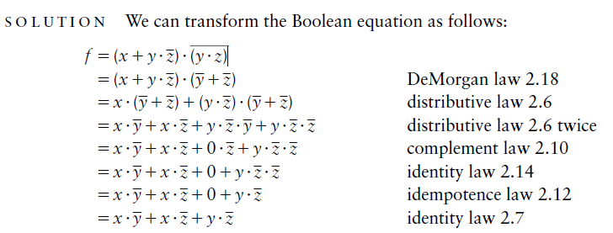
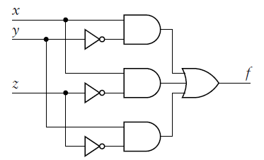
Example – Solution

Slide 12
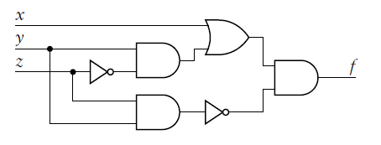
Example – Discussion

Slide 13

Questions

